Slide 1
Project 2

Slide 2
Network Topology

Slide 3
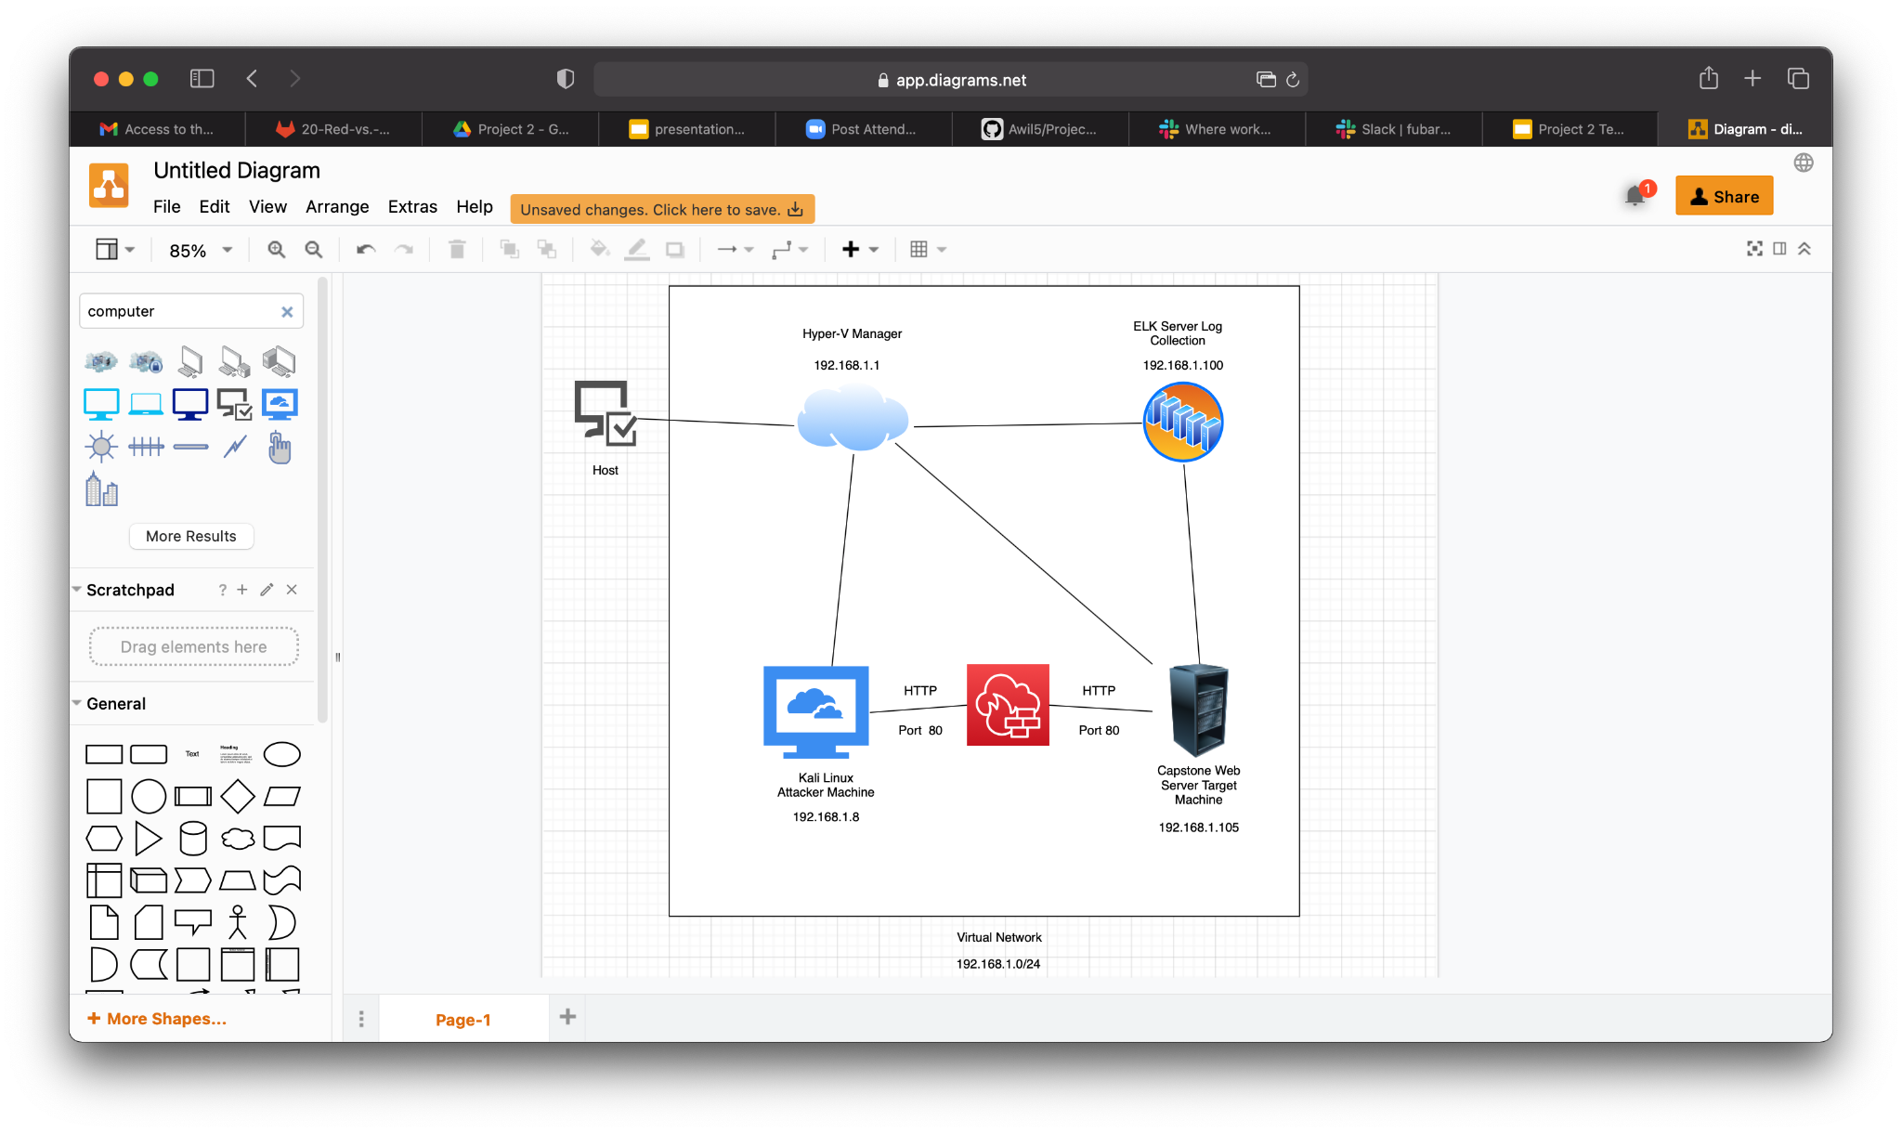
Network
Address Range:
19.168.1.0/24
Netmask: 255.255.255.0
Gateway: 192.168.1.1
Network Topology
Machine
IPv4: 192.168.1.1
OS: Windows
Hostname: Hyper-V Manager
IPv4: 192.168.1.8
OS: Kali Linux
Hostname: Kali
IPv4: 192.168.1.105
OS: Linux
Hostname : Capstone
IPv4: 192.168.1.100
OS: Linux
Hostname: ELK

Slide 4
Red Team
Security Assessment

Slide 5
Describing the Target
Hostname
IP Address
Role on Network
This is the target machine using the apache web server.
Capstone
192.168.1.105
This is the attacking machine using the Kali Linux.
Kali
192.168.1.8
Centralized logging service to identify problems in a server or application
Elk
192.1.100
Software that virtualized hardware into virtual machines/servers
Hyper V Manager
192.168.1.1

Slide 6
Vulnerability Assessment
Vulnerability
Description
Impact
The software uses external input to conduct a pathname that should be within a restricted directory, but it does not properly neutralize sequences such as “..” that can resolve to a location that is outside of that directory.
CWE-23: Relative Path Traversal
This will allow the attacker to obtain knowledge of hidden directories on the system.
The software does not implement sufficient measures to prevent multiple failed authentication attempts within in a short time frame, making it more susceptible to brute force attacks.
This will allow the attacker to run dictionary based attacks to obtain credentials
CWE-307: Improper Restriction of Excessive Authentication Attempts
CWE-98: Improper control of Filename for Include/Require Statement in PHP Programs
The PHP application receives Input from an upstream component, but it does not restrict or incorrectly restricts the input before its usage in “require”, “include”, or similar functions.
This will allow the attacker to use remote file inclusion to be able to run code on a server

Slide 7
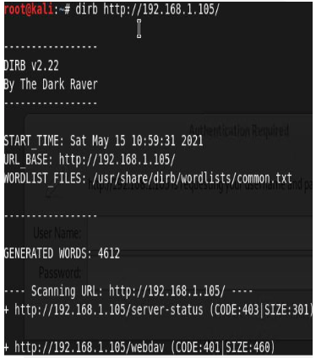
CWE-23: Relative Path Traversal
Tools and processes
Achievements
Used the “dirb” command to launch a dictionary based attack against the web server. Dirb looks for existing or hidden web objects
Using this tool granted the knowledge of two hidden directories within the web server.

Slide 8
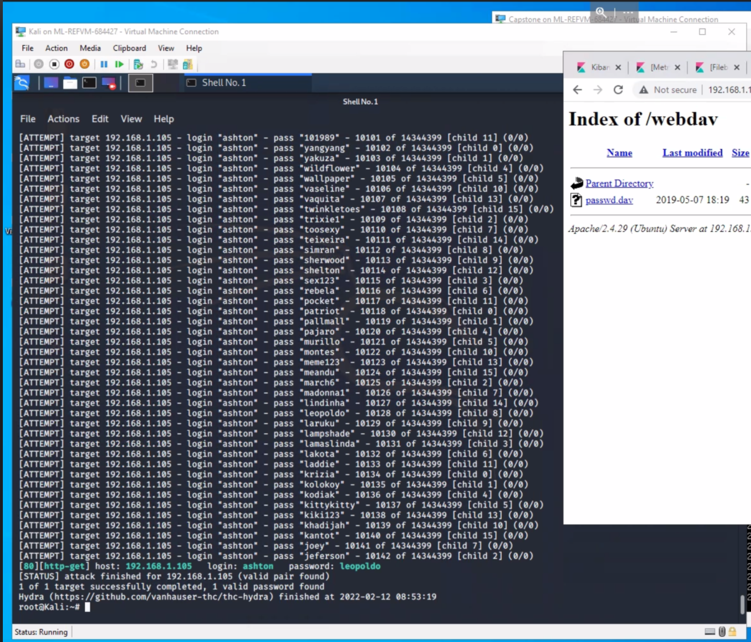
CWE-307: Improper Restriction of Excessive Authentication Attempts
Tools and processes
Achievements
The Hydra was used to run brute force attack on the credentials for the secret_folder directory
This was able to produce the credentials, ashton:leopoldo for access to the secret_folder directory

Slide 9
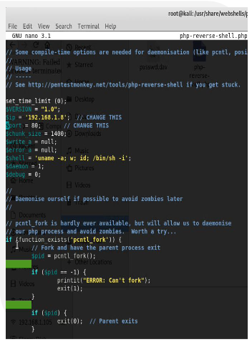
CWE-98: Improper Control of Filename for Include/Require statement in PHP Program
Tools and processes
Achievements
Able to upload or reverse shell code without the server restricting the input before its usage.
Once the code was executed it provided access to the time to server using a reverse shell

Slide 10
Blue Team
Log Analysis and
Attack Characterization

Slide 11
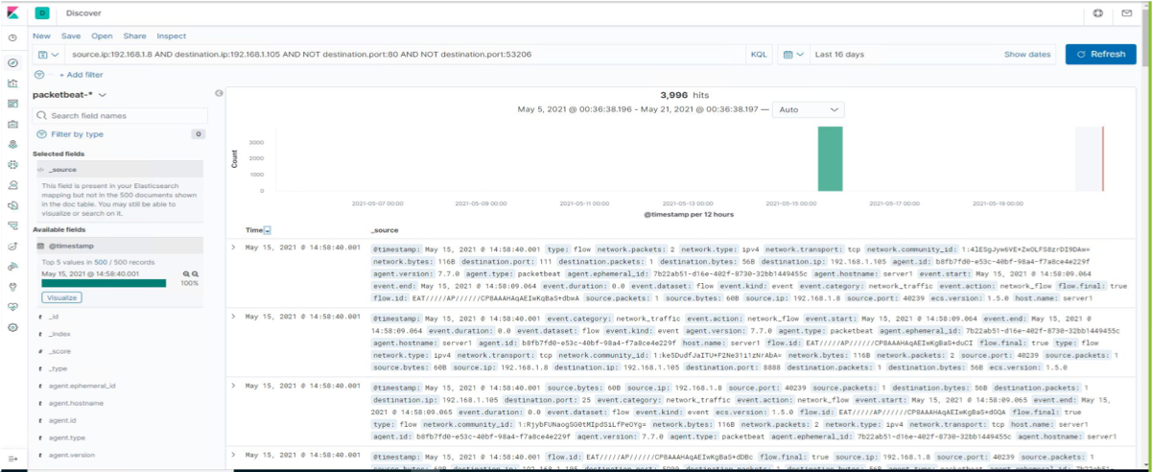
Analysis: Identifying the Port Scan
The Port scan occurred at 2:58pm
There were 3,996 packets sent from the IP address 192.168.1.8
A few thousand requests all for different port numbers

Slide 12
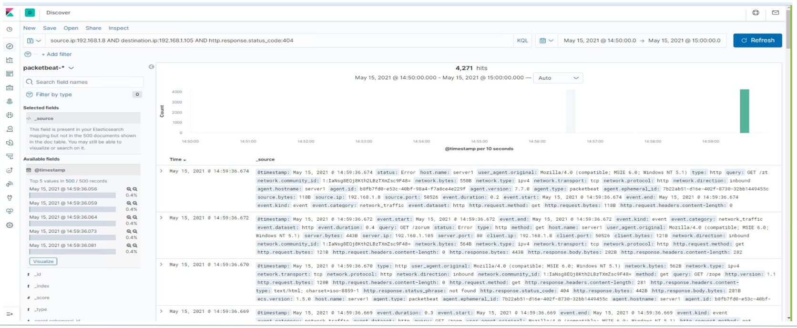
Analysis: Finding the Request for the Hidden Directory
At 2:59pm 4,271 requests were made
Each request was for a different directory from the DIRB wordlist, it identified two directories, server status, and webdav.

Slide 13
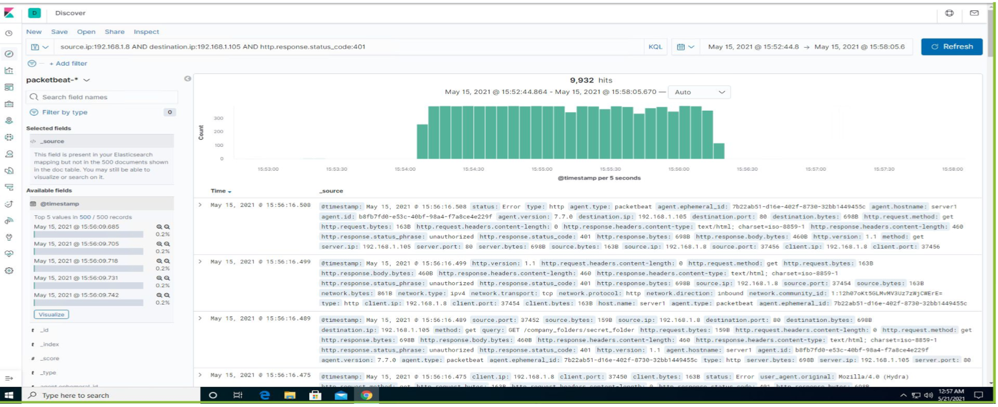
Analysis: Uncovering the Brute Force Attack
9,932 requests were made during the attack.
Once the credentials were found the hydra application stopped sending requests, so they were all needed.

Slide 14
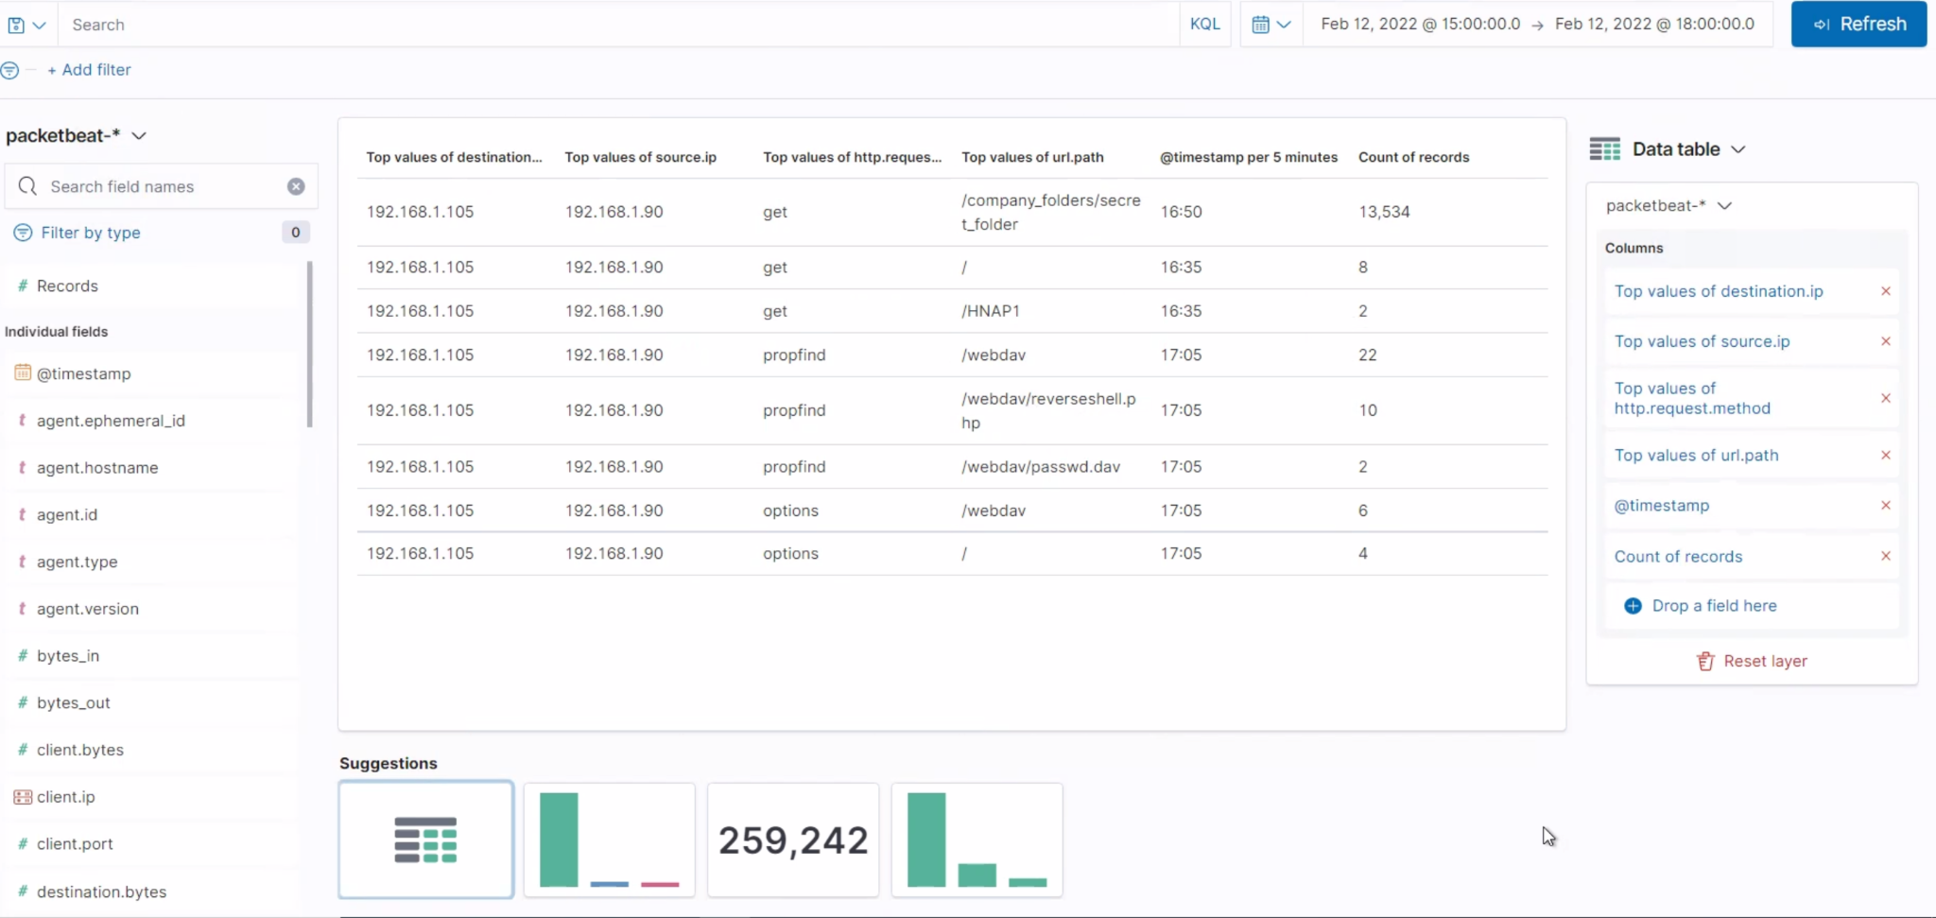
Analysis: Finding the Webdav Connection
22 total request were made to the webdav directory.
The php-reverse-shell.php file was requested several times.

Slide 15
Blue Team
Proposed Alarms and Mitigation Strategies

Slide 16
Mitigation: Blocking the Port Scan
Alarm
System Hardening
What kind of alarm can be set to detect future port scans?
What configurations can be set on the host to mitigate port scans?
A filter can be activated if detected traffic from a single source IP address is connecting to different ports
Install a firewall, an IPS can detect port scans and shut them down.
What threshold would you set to activate this alarm?
Describe the solution. If Possible, provide required command lines.
Any IP attempting to access closed ports should have the filter activate.
Filtering traffic from an IP triggered by the IPS can effectively mitigate port scans.

Slide 17
Mitigation: Finding the request for the Hidden Directory
Alarm
System Hardening
What kind of alarm can be set to detect future unauthorized access?
What configuration can be set on the host to block unwanted access?
An alarm could be set to go off for any IP address not on the whitelist that attempts to access.
This directory should not be allowed to exist on the server.
What threshold would you set to activate this alarm?
Describe the solution. If possible, provide required command lines.
The threshold for this alarm would be 1, for any machine accessing it.
rmdir -r This can be used to remove all files and the directory itself from the server.

Slide 18
Mitigation: Preventing Brute Force Attacks
Alarm
System Hardening
What kind of alarm can be set to detect future brute force attacks?
What configuration can be set on the host to block brute force attacks?
An alert can be created if 401 Unauthorized is returned from the server over a threshold.
Limit failed login attempts
Limit logins to a whitelist of IP addresses
What threshold what do you say to activate this alarm?
Describe the solution. If possible, provide the required command line.
Start with 5 over a 30 minute period to allow forgotten or mistyped passwords and refine.
Configure account policies on your server to limit failed login attempts

Slide 19
Mitigation: Detecting the WebDAV connection
Alarm
System Hardening
What kind of alarm can you set to detect future access to this directory?
What configuration can be set on the host to control access?
Set an alert for any blacklisted IP attempting to access this directory
Connections to this shared folder should not be accessible from the web and restricted by the machine using a blacklist firewall rule.
All IPs outside the server range should be blacklisted
What threshold would you set to activate this alarm?
Describe the solution. If possible, provide the required command line.
Blocking ports 80 and 443
Blacklisting all external IPs
The threshold for this alarm should be 1, any attempt to access should trigger alarm.

Slide 20
Mitigation: Identifying Reverse Shell Uploads
Alarm
System Hardening
What kind of alarm can be set to detect future file uploads?
What configuration can be set on the host to block file uploads?
Set an alert for any .php file that is uploaded
Set firewall to block traffic to the shared folder on ports 80, 443, and 4444
Remove the ability to upload files from over the web, all file uploads should be from a local source.
What threshold would you set to activate this alarm?
Describe the solution. If possible, provide the required command line.
Any traffic on these ports would warrant a alarm trigger.
Block port 80, 443, and 4444

